Slide 1
MUSIC MADNESS!
Group 6 Members: Matthew Gayle, Zeke Shoemaker, Sam Wilson, Patrick Chen, Ellen Gebreyohannes

Slide 2
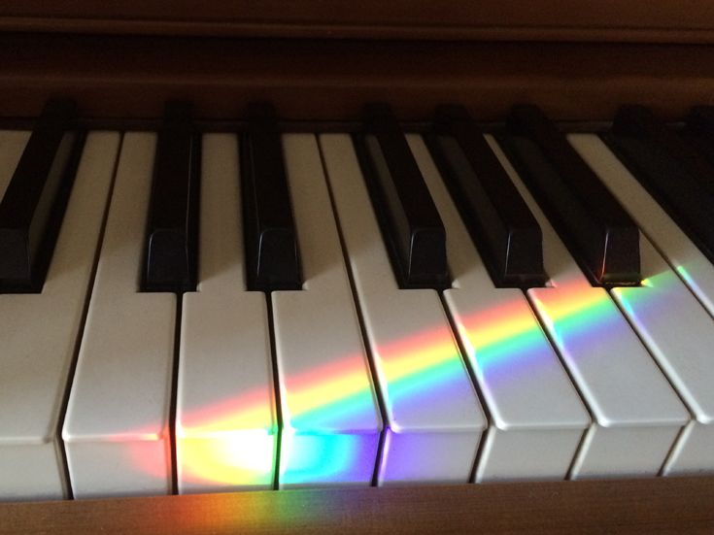
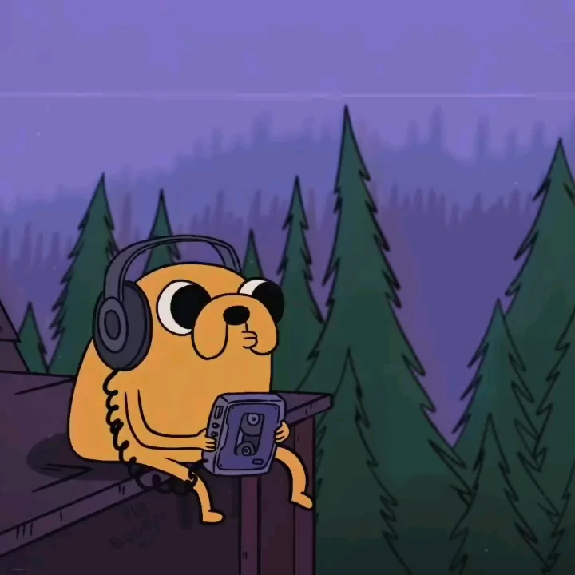
PROJECT BRIEF SUMMARY:
Music Madness is a music album review site that allows users to browse popular albums and share their opinion about it ! It is meant to be a safe space for music lovers to express their passion for music.

Slide 3

RESPONSIBILITY MATRIX
 | Style/Design | Back-end | Initial feature implementation | Debugging | Testing
Matthew | a | p | s | p | s
Zeke | s | p | p | s | s
Ellen | p | s | p | a | s
Sam | p | s | s | p | a
Patrick | a | s | s | p | p
(p- primary) (s- secondary) (a- auxiliary)

Slide 4

GROUP REVIEW
What Worked… | What didn’t…
Every member put forth an honest effort to contribute Improved workflow over the course of the semester Having a group leader to oversee the group activity | Communication and scheduling meeting times Lost direction at times

Slide 5
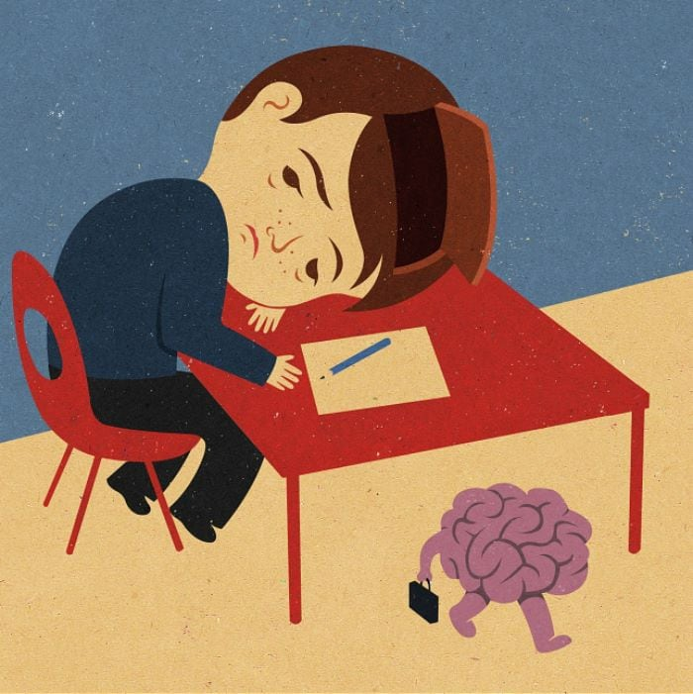
MAJOR PROBLEMS AND WHAT WE LEARNED…
Problem: Our schedules did not align
Solution: Created a shareable document that covered
what we talked about in the meetings
Problem: Skill gaps
Solution: We had to switch around responsibilities based on
Who was more capable of getting the job done

Slide 6

PROBLEMS CONTINUED (TECHNICAL)...
Problem: Issues with CSS, couldn’t get things to align right always. Had to
be a little rushed, in favor of more work on functionality.
Problem: Various errors with PHP, due to the complexity of when different attributes were needed across multiple
tables.
Problem: Code generally not the cleanest, since we had to learn as we went, and definitely underutilized PHP
functions, and quite a few redundant CSS divs.
Key Takeaway: the thing that strengthened the group
Was our ability to adapt to these challenges

Slide 7
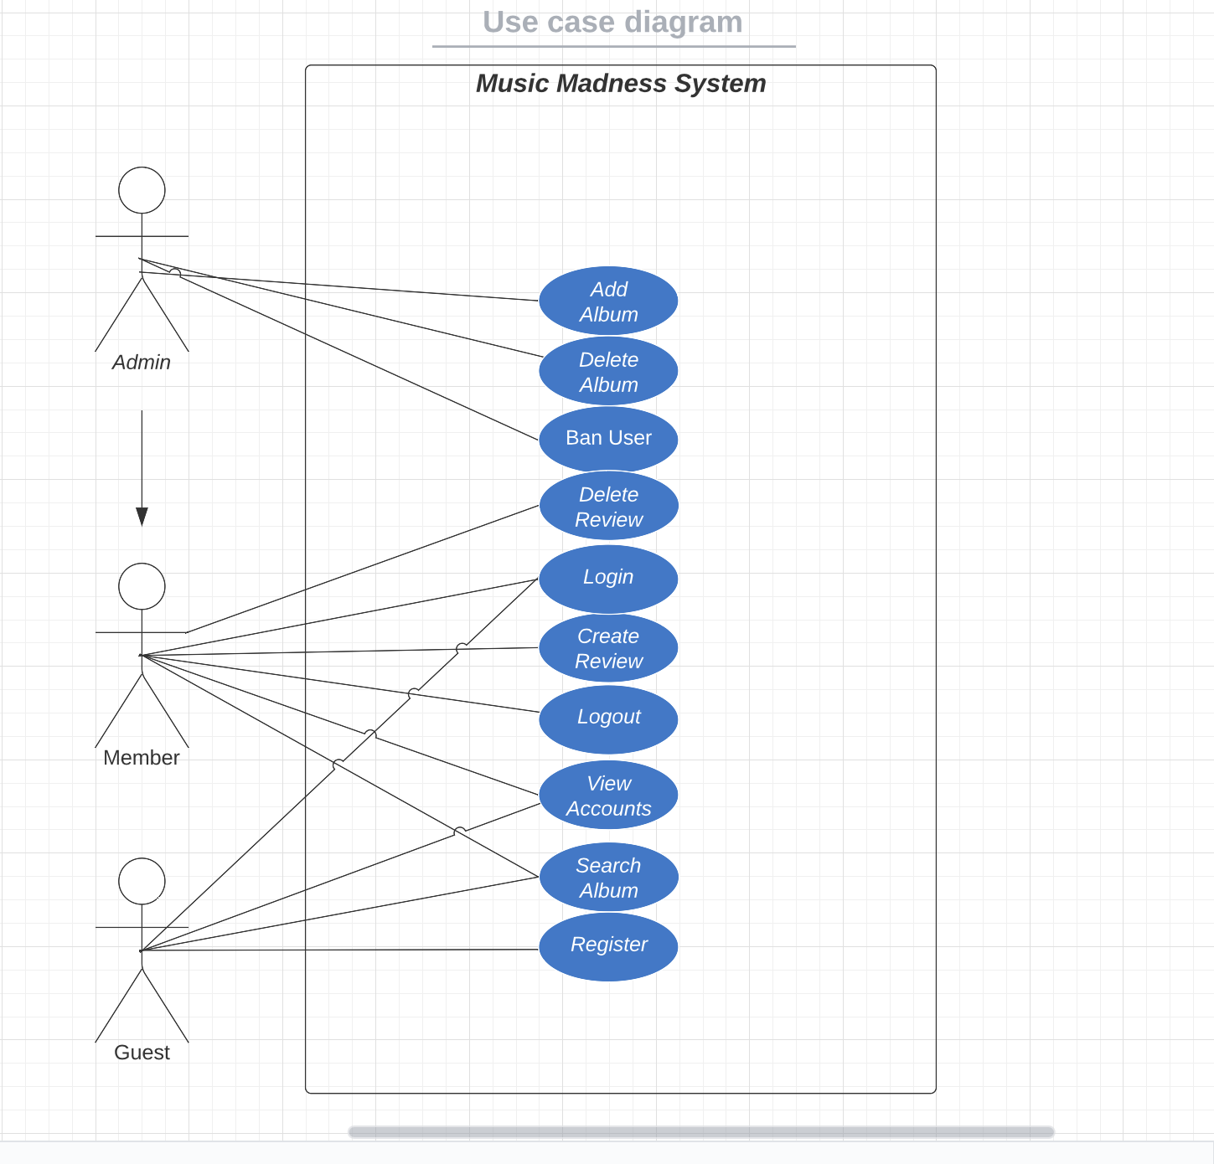
USE-CASE DIAGRAM

Slide 8
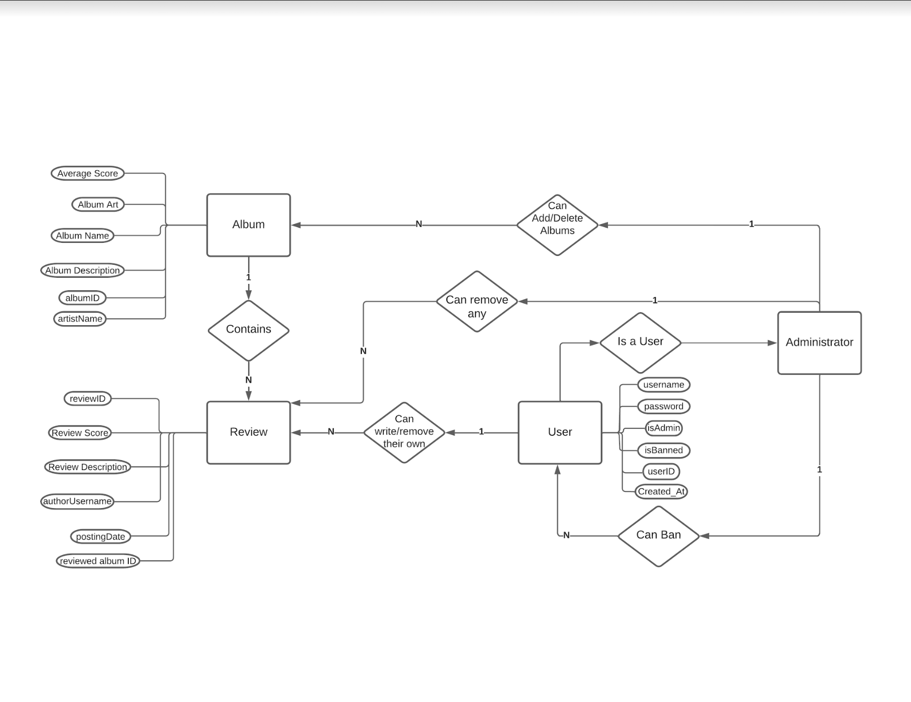
ER-DIAGRAM

Slide 9
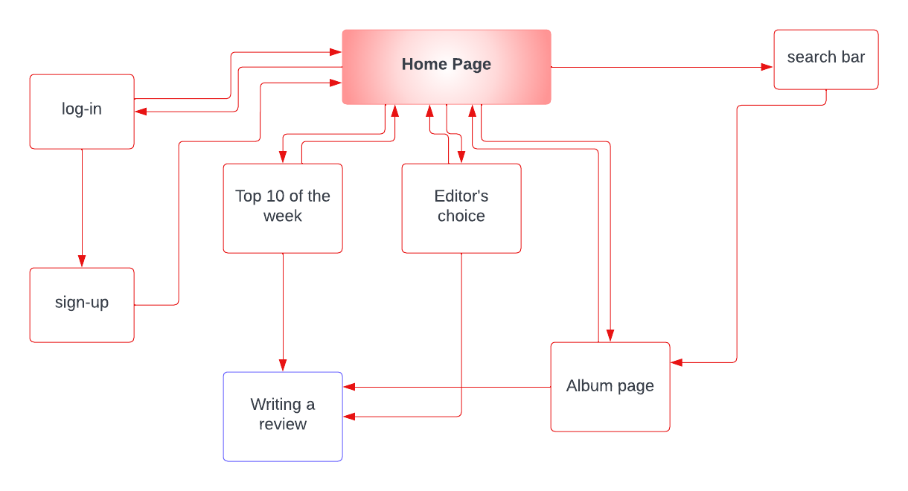
NAVIGATIONAL CHART

Slide 10
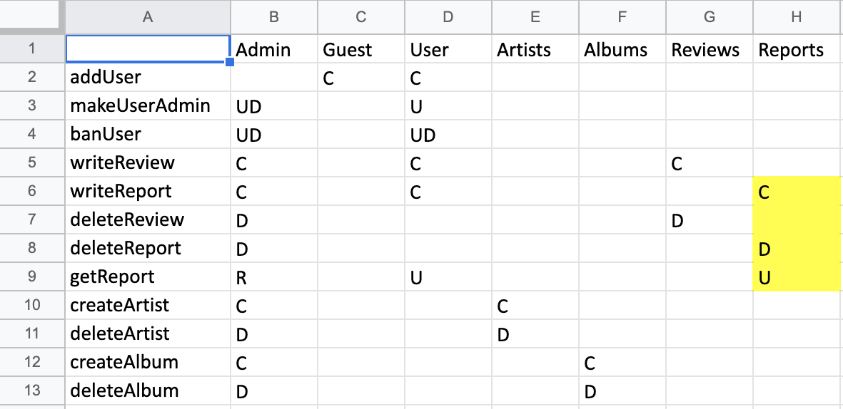
CRUD MATRIX

Slide 11
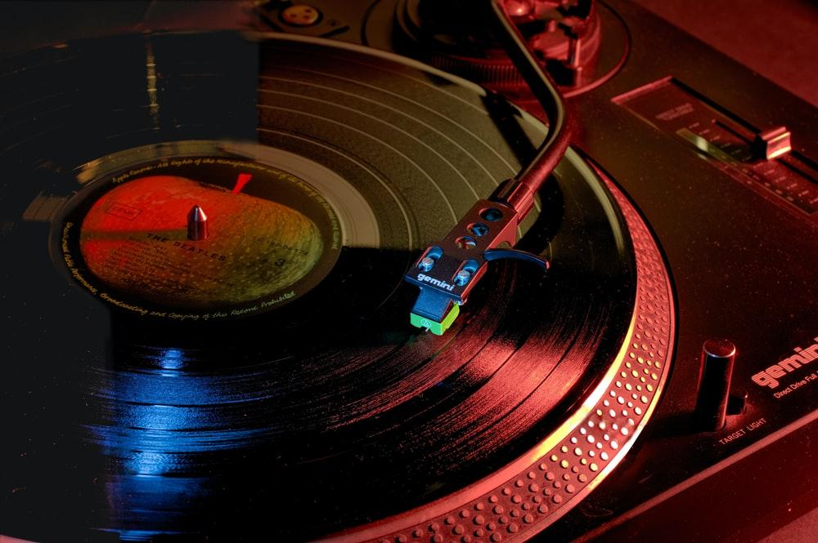
WEBSITE DEMO…

